Slide 1
The Goodness of God in My Life
Sunday 15th September 2024
Judith Acreman

Slide 2
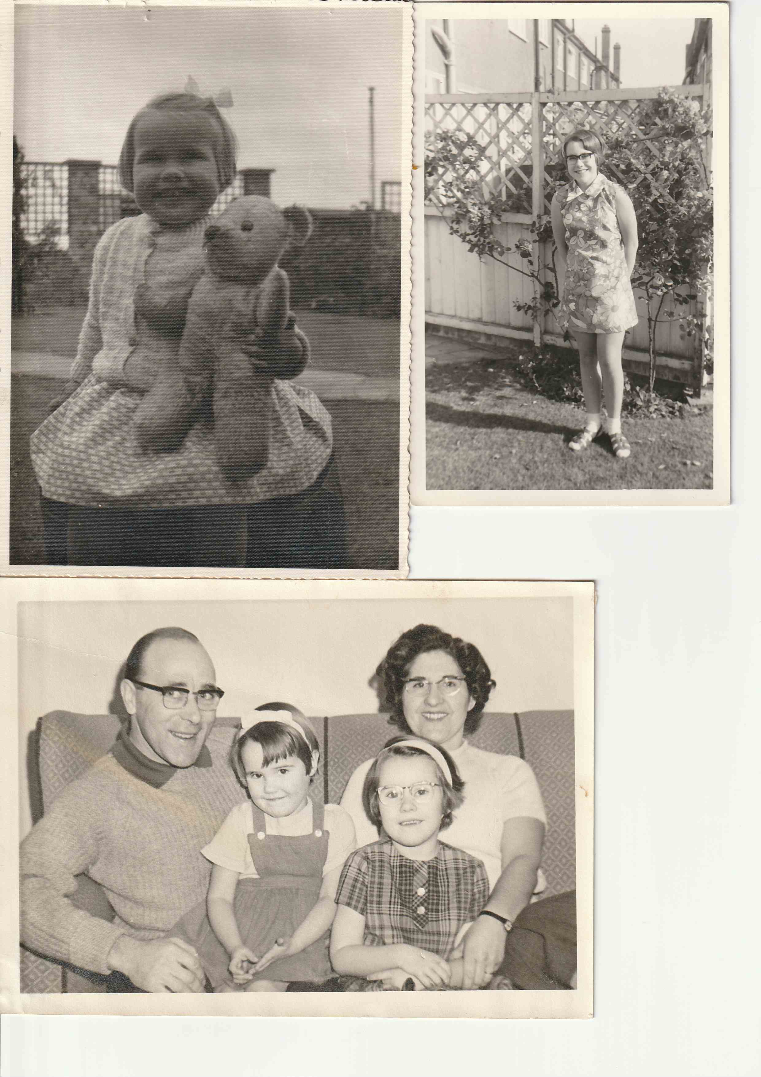
CHILDHOOD

Slide 3
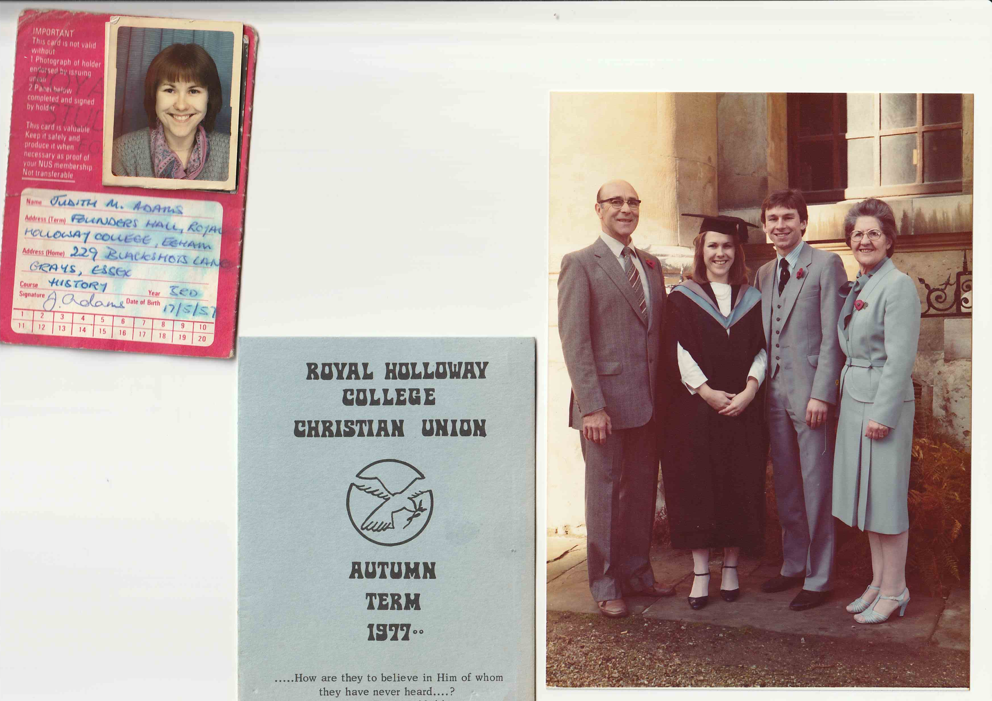
UNIVERSITY

Slide 4
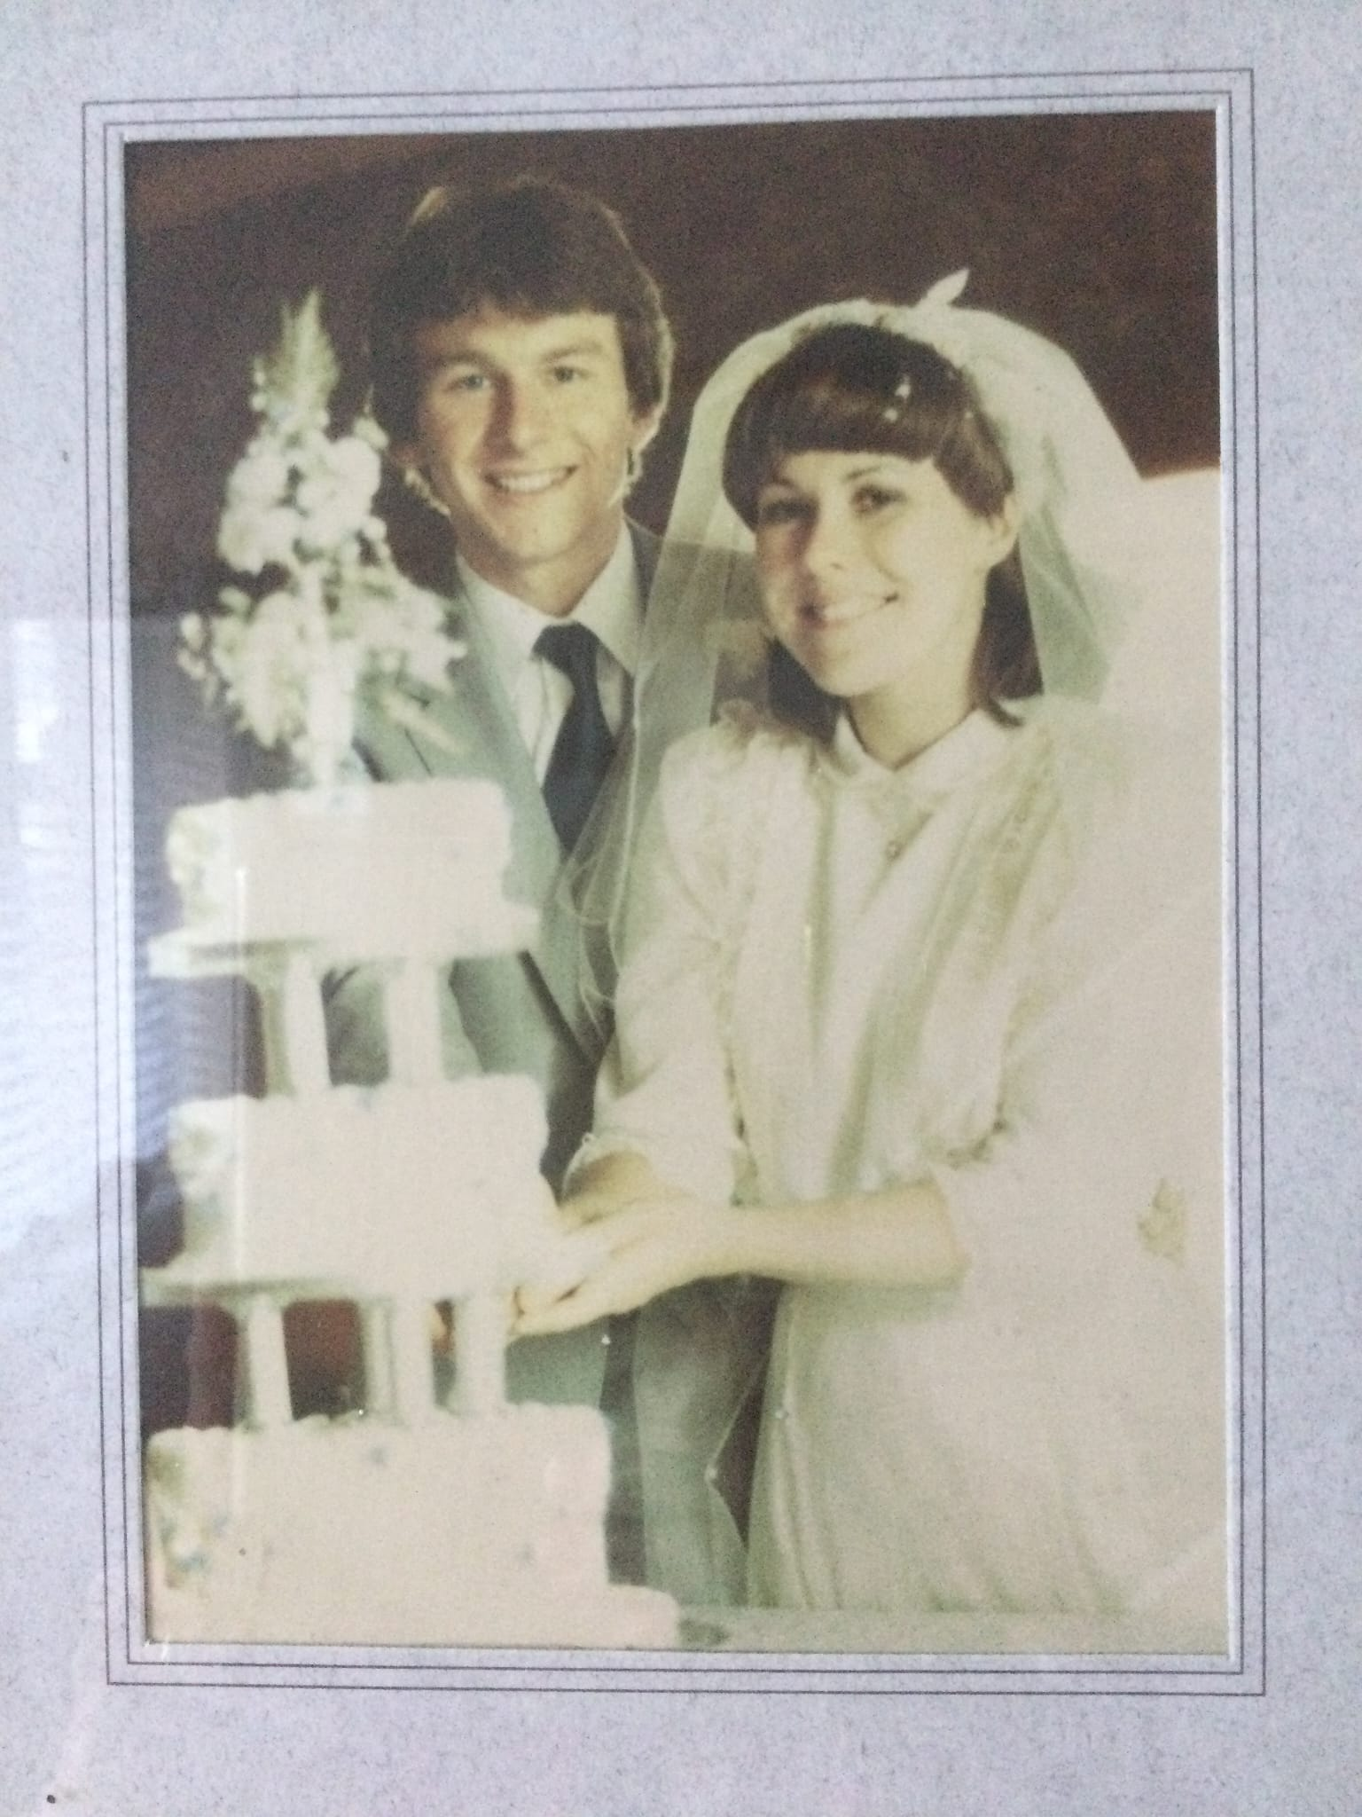

Slide 5
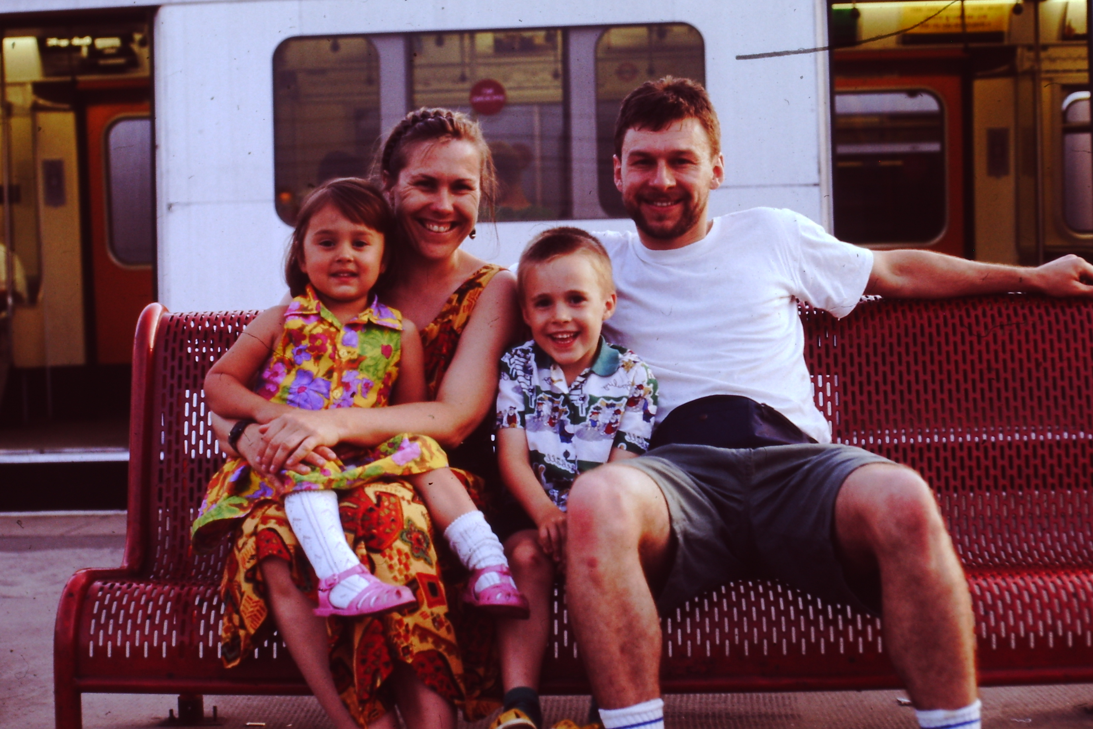

Slide 6
What I have learned (1)
You don’t have to learn by making mistakes. Don’t be stubborn! Be teachable by other believers (alive and dead!)
Jesus is always right, and always good. You can trust him absolutely. Joy, peace freedom & fulfilment are all found by following Him.
He does not expect a lot, the tiniest move of obedience to Him and he multiplies our intentions and efforts thousandfold. (Like power steering).
Take the Bible more literally and don’t overthink ‘what ifs’ and next steps. We are not supposed to understand why.

Slide 7
What I have learned (2)
You won’t always know what will happen next. Following Jesus means we are behind him, so we can’t see ahead.
Every choice and decision I make every single day impacts on my overall course in life.
His timing is perfect so if he seems to delay – it’s not time yet!
Don’t automatically trust your feelings – they can mislead. They need to line with the word of God and other wisdom.
It gets easier as you build a history of trusting God.

Slide 8
Psalm 139 ‘God knows me and cares about me’
¹ Lord, you have seen what is in my heart.
You know all about me.
² You know when I sit down and when I get up.
You know what I’m thinking even though you are far away.
³ You know when I go out to work and when I come back home.
You know exactly how I live.
⁴ Lord, even before I speak a word,
you know all about it.
⁵ You are all around me, behind me and in front of me.
You hold me safe in your hand.
⁶ I’m amazed at how well you know me.
It’s more than I can understand………..

